Slide 1
Linguistics 200, Week 8
Nominals

Slide 2
Today: Nominals
What are nominals?
What are the three types of nominals?
What sorts of information can languages add to nominals?
Number
Gender/Noun Classes
Case

Slide 3
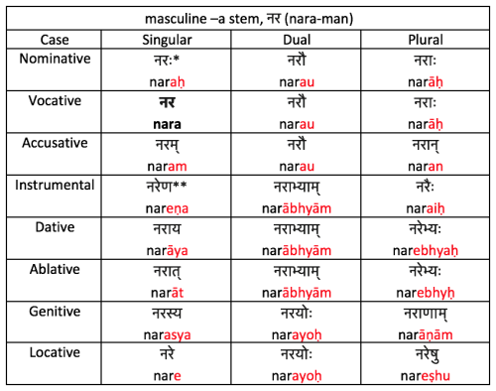
Do you want a language with lots of morphology?

Slide 4
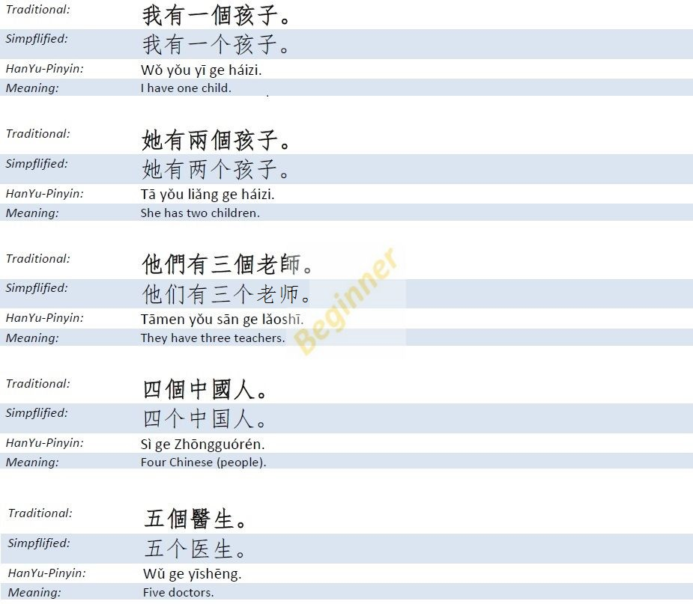
Or very little?

Slide 5
For the most part
Lots of morphology = word order doesn’t matter
Not much morphology = word order matters A LOT
Most languages are somewhere in the middle

Slide 6
Last Time
The Lexicon

Slide 7
The Next 3 Days: Creating your Nominal System
Go to your lexicon & identify down 7 nouns that you’ve created thus far
You will decide:
Number
Gender
Case
If no case, how do you indicate location, source, instrument, and possession?
You will decide:
Adjectives and their relationship w/ nouns
You will create:
Pronoun system

Slide 8
Group Activity: What is Grammatical Number?
What is it?
How many can a language have?
Feel free to use Internet/AI

Slide 9
Which type of system did you find coolest?
https://en.wikipedia.org/wiki/Grammatical_number

Slide 10
But how can number be 'marked'?
Through "affixes"
There are five types:
Prefixes
Suffixes
Infixes
Circumfixes
Interweaving (Ablaut)

Slide 11
In Mɤɧøɴ: singular, dual, plural
We could just do this:
iɴ ‘metra’
iɴi ‘2 metras ’ SUFFIX
iɴu ‘metras’
pi ‘foot’
ipi ‘2 feet’ PREFIX
upi ‘feet’

Slide 12
In Mɤɧøɴ: singular, dual, plural
We could just do this:
iɴ ‘metra’
iwiɴ ‘2 metras ’ INFIX
iwuɴ ‘metras’
pi ‘foot’
ipiyi ‘2 feet’ CIRCUMFIX
upiwu ‘feet’

Slide 13
In Mɤɧøɴ: singular, dual, plural
We could just do this:
iɴ ‘metra’
oɴ ‘2 metras ’ INTERWEAVING
uɴ ‘metras’

Slide 14
Here’s what we did:
iɴ ‘metra’ we ‘dinosaur’
iɴɠuɴ ‘2 metras ’ weɠum ‘2 dinos’
iɴɣikaɴ ‘metras’ weɣikan ‘dinos’
qiŋ ‘seed’ pi ‘foot’
qiŋɠuŋ ‘2 seeds ’ piɠum ‘2 feet’
qiŋɣikaŋ ‘metras’ piɣikan ‘feet’

Slide 15
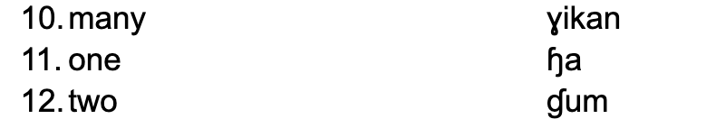
In Mɤɧøɴ: singular, dual, plural

Slide 16
Something else is going on here, phonologically…
iɴ ‘metra’ we ‘dinosaur’
iɴɠuɴ ‘2 metras ’ weɠum ‘2 dinos’
iɴɣikaɴ ‘metras’ weɣikan ‘dinos’
qiŋ ‘seed’ pi ‘foot’
qiŋɠuŋ ‘2 seeds ’ piɠum ‘2 feet’
qiŋɣikaŋ ‘metras’ piɣikan ‘feet’

Slide 17
Let’s think about the Dorgons (Dgon)
How many numbers should we have?
Translate:
1 individual from your society (Dorgon)
2 Dorgons
3 Dorgons
4 Dorgons

Slide 18
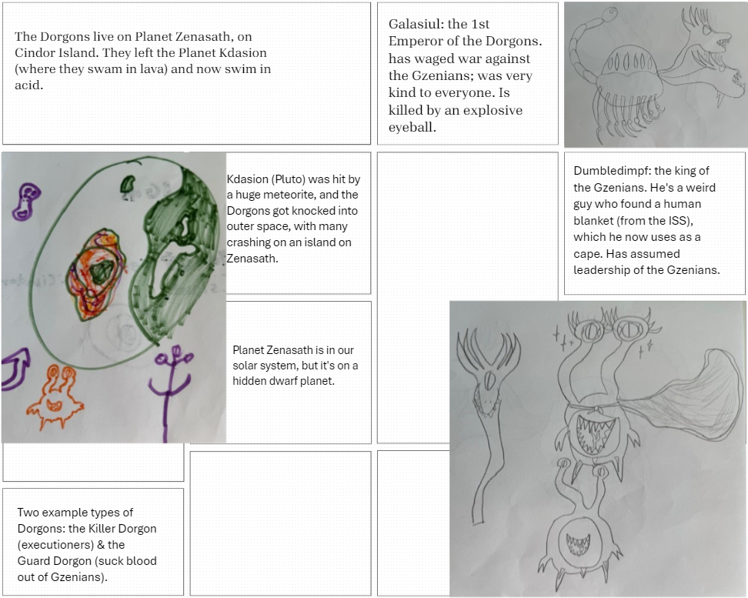
Activity: with your group, discuss: what grammatical numbers should the Dorgons have?

Slide 19
Affixation?
dwarf ɳm̩pfa
short ɳm̩pf
dorgon pit xʁaɪs
confused dpθ̩mɳ̩
someone who is confused; idiot dpθ̩mɳa
king coɳɟa
ruling; being in charge coɳɟ

Slide 20
Activity -- make different number forms
How many numbers do you have?
Translate:
1 individual from your society (Metra, Dorgon, etc.)
2 i.f.y.s.
3 i.f.y.s.
4 i.f.y.s.

Slide 21
For Next Time
Identify the grammatical numbers you want in your language, if any
Will you have affixation? If so, what time?

Slide 22
Linguistics 200, Week 8
Nominals

Slide 23
Review
Nominals
Grammatical Number
Types of Affixes

Slide 24
What is Gender?
What is it?
How many can a language have?
What types of categories can the language have?

Slide 25
Group Activity: How many genders are possible? And what types?

Slide 26
Examples of Gender?
https://en.wikipedia.org/wiki/Grammatical_gender
https://en.wikipedia.org/wiki/Noun_class

Slide 27
In Mɤɧøɴ: four genders
Metras: çampa “Chomper”
All other animals (including dinosaurs): we “dinosaur”
Underwater plants: ɓiŋ “seaweed”
Everything else (including above-water plants): ɧø “horn”

Slide 28
How is it marked?
On adjectives -- insert sound sequence before last vowel of word:
çampa ɠuŋɤm → çampa ɠuŋowɤm ‘big Chomper’
we ɠuŋɤm → we ɠuŋʀɤm ‘big dino’
ɓiŋ ɠuŋɤm → ɓiŋ ɠuŋsɤm ‘big seaweed’
ɧø ɠuŋɤm → ɧø ɠuŋtɤm ‘big horn’

Slide 29
Dorgon - Number
dpθ̩mɳa 'idiot'
kedpθ̩mɳa '2 idiots'
ekedpθ̩mɳa 'many idiots'
akedpθ̩mɳa ‘a few idiots'

Slide 30
Dorgon Gender – What makes sense?
Elijah's Lexicon.docx

Slide 31
Number, Gender, Case – Order?
Cross-linguistically, there tends to be a hierarchy:
Prefixes:
NUMBER + CASE + GENDER
Suffixes:
GENDER + CASE + NUMBER

Slide 32
Dorgon - Number
dpθ̩mɳa 'idiot'
kedpθ̩mɳa '2 idiots'
ekedpθ̩mɳa 'many idiots'
akedpθ̩mɳa 'a bunch of idiots'

Slide 33
Activity -- make different gender forms
How many genders do you have, if any?
Write out at least one noun for each gender category you’ve created, and indicate how gender is marked.

Slide 34
What is Case?
What is it?
How many can a language have?
What types of categories can the language have?

Slide 35
Examples of Case?
English
Latin
Beyond?

Slide 36
In Mɤɧøɴ: no case
Subject & object marked by word order, not case.
Location, source, instrument, possession marked with prepositions:
Location: in Undersplash ɓɤ-wisiyesi
Source: from Undersplash ɧaŋ-wisiyesi
Instrument: with Chomper ti-çampa
Possession: Chomper’s xɤ-çampa

Slide 37
Dorgon?
From Elijah:
‘before’ da
‘after’ ba

Slide 38
Activity -- make different case forms
Does your language make use of case? If so, how many cases will you have?
Does your language have different forms for subject and object nominals?
Indicate the case forms or prepositions/postpositions used for the following meanings, complete with translated expressions from your language:
Location:
Source:
Instrument:
Possession:

Slide 39
Linguistics 200, Week 8
Nominals

Slide 40
Nominals
We've now talked about:
Grammatical Number
Gender
Case
Affixation

Slide 41
Some Clarification about Gender
Natural vs. Grammatical
English pronouns
Spanish masculine & feminine

Slide 42
Some Clarification about Case
Grammatical Cases (Word Order)
Grammatical Cases (Adpositions)

Slide 43
Dgon: dpθ̩mɳa 'idiot'
subject pfodpθ̩mɳa
dir. obj. dpθ̩mɳa
indir. obj. udpθ̩mɳa
‘before’ badpθ̩mɳa
‘after’ dadpθ̩mɳa
‘from’ ikadpθ̩mɳa
‘with’ idpθ̩mɳa
‘of’ sxdpθ̩mɳa
Zipf’s

Slide 44
Note what happens when we add number prefixes
subject kepfodpθ̩mɳa
dir. obj. kedpθ̩mɳa
indir. obj. keudpθ̩mɳa
‘before’ kebadpθ̩mɳa
‘after’ kedadpθ̩mɳa
‘from’ keikadpθ̩mɳa
‘with’ keidpθ̩mɳa
‘of’ kesxdpθ̩mɳa
Zipf’s

Slide 45
Good place for a phonotactic rule
subject kepfodpθ̩mɳa
dir. obj. kedpθ̩mɳa
indir. obj. keudpθ̩mɳa
‘before’ kebadpθ̩mɳa
‘after’ kedadpθ̩mɳa
‘from’ keikadpθ̩mɳa
‘with’ keidpθ̩mɳa
‘of’ kesxdpθ̩mɳa
Zipf’s
Diphthong?
C insertion?
V deletion?

Slide 46
What does this mean?
dgon ‘Dorgon’ dçi ‘stick’ dpθ̩mɳa ‘idiot’
pfo- = subject -0- = DO -u- = IO
“The idiot GAVE the Dorgon a stick.”
pfodpθ̩mɳa GAVE udgon dçi
“The Dorgon GAVE the idiot a stick.”
pfodgon GAVE udpθ̩mɳa dçi
“The stick GAVE the Dorgon the idiot.”
pfodçi GAVE udgon dpθ̩mɳa
Word Order?

Slide 47
Adjectives & Nouns
How are adjectives marked in relation to the nouns they modify?

Slide 48
Examples in English: Agreement
The cat is small.
The cats are small. not *The cats are smalls.
The black cat walked.

Slide 49
Agreement in English
Make plural:
This cat is small.
That cat is small.

Slide 50
Examples in Spanish (source): Agreement
El gato es pequeño. ‘The cat is small.’
Los gatos son pequeños. ‘The cats are small.’
El gato negro caminó. ‘The black cat walked.’

Slide 51
Examples in German (source)
Attributive – requires agreement
der große Baum ‘the big tree’
Der Baum ist groß. ‘The tree is big.’
Predicative – no agreement

Slide 52
In Mɤɧøɴ: adjectives marked for (natural) gender, not number
çampa ɠuŋɤm → çampa ɠuŋowɤm ‘big Chomper’
we ɠuŋɤm → we ɠuŋʀɤm ‘big dino’
ɓiŋ ɠuŋɤm → ɓiŋ ɠuŋsɤm ‘big seaweed’
ɧø ɠuŋɤm → ɧø ɠuŋtɤm ‘big horn’

Slide 53
Dgon Adjectives: Incorporation
So far we’ve seen that Dgon has prefixed number & case, suffixed POS markers:
ke-pfo-dpθ̩mɳ-a
‘2 idiots (subject)’

Slide 54
Inuktitut
aqpik ‘cloudberry’ + juk ‘small’ → aqpikjuk ‘small cloudberry’
sila ‘weather’ + angijuq ‘big’ → silangijuq ‘bad weather’
Adjectives are regularly ‘incorporated’ into the noun. This is similar to phrases like ‘baby-sitting’ or ‘doom-scrolling’.

Slide 55
Dgon Adjectives: Incorporation
ke-pfo-dpθ̩mɳ-a
‘2 idiots (subject)’

Slide 56
Dgon Adjectives: Incorporation Example
Why here?
Let’s incorporate im ‘small’:
ke-pfo-dpθ̩mɳ-im-a
‘2 small idiots (subject)’

Slide 57
Dgon Adjectives: Incorporation Example
Let’s incorporate gpfa ‘big’.
ke-pfo-dpθ̩mɳ-a
‘2 big idiots (subject)’

Slide 58
Activity – Dorgon adjectives
‘fire’ den
‘eyes (pl.)’ ekepkin
‘belly’ xi
‘retractable belly spikes’ ampf
‘red’ ge
‘many’ gti
‘full’ ban
‘black’ pça
Translate the following adjective + noun expressions:
red fire
many eyes
full belly
black hair

Slide 59
Activity -- adjectives
Are your adjectives marked for number? Gender? Case? (Don’t worry about word order for the time being.)
Translate the following adjective + noun expressions:
red fire
many eyes
full belly
black hair

Slide 60
Pronouns
How are they connected to the nominal system?

Slide 61
In Mɤɧøɴ: match the categories from earlier
sg. du. pl.
1st person kɤ kɤɠu kɤka
2nd person ku kuɠu kuka
3rd person (met) o oɠu oka
(animal) ʀɤ ʀɤɠu ʀɤka
(plant) sø søɠu søka
(other) ta taɠu taka

Slide 62
Compare…
sg. du. pl.
1st person kɤ kɤɠu kɤka
2nd person ku kuɠu kuka
3rd person (met) o oɠu oka
(animal) ʀɤ ʀɤɠu ʀɤka
(plant) sø søɠu søka
(other) ta taɠu taka
çampa ɠuŋɤm → çampa ɠuŋowɤm ‘big Chomper’
we ɠuŋɤm → we ɠuŋʀɤm ‘big dino’
ɓiŋ ɠuŋɤm → ɓiŋ ɠuŋsɤm ‘big seaweed’
ɧø ɠuŋɤm → ɧø ɠuŋtɤm ‘big horn’

Slide 63
Activity – Dorgon pronoun system
Let’s create a table of pronouns with 1, 2, 3 on the left side. Include along the top the numbers you’ve posited for your language.
 | sg. | du. | pl. | paucal
1 | do ‘I’ | ke-do ‘we 2’ | eke-do ‘we’ | ake-do ‘a few of us’
2 | ço ‘you’ | ke-ço ‘you 2’ | eke-ço ‘y’all’ | ake-ço ‘a few of y’all’
3 anim. inanim. | a ‘they’ un ‘it’ | ke: ‘they 2’ kew ‘they 2’ | eke: ‘they (pl.)’ ekew ‘they’ | ake: ‘a few of them’ akew ‘a few of them’

Slide 64
Summary: Dgon Nominals
Numbers (4): sg., du., pl. paucal
Genders (2): natural – animate, inanimate
Cases (8): grammatical & prepositional (oblique)
Adjectives: incorporated (compounded within Ns)
Pronouns: 4 numbers, 2 genders, prefixed cases

Slide 65
Pronouns – need to reflect case, too!
a ‘they (sg.)’
subject pfodpθ̩mɳa pfa ‘they’
dir. obj. dpθ̩mɳa a ‘them’
indir. obj. udpθ̩mɳa wa ‘to/for them’
‘before’ badpθ̩mɳa ba ‘before them’
‘after’ dadpθ̩mɳa da ‘after them’
‘from’ ikadpθ̩mɳa ika ‘from them’
‘with’ idpθ̩mɳa ja ‘with them’
‘of’ sxdpθ̩mɳa sxa ‘their’
By rule!

Slide 66
Activity – Your pronoun system
Create a table of pronouns with 1, 2, 3 on the left side. Include along the top the numbers you’ve posited for your language.
 | sg. | du. | pl.
1
2
3

Slide 67
2. If you want your pronouns to be marked for gender, indicate this here.
 | sg. | du. | pl.
1
2
3 masc. fem. neut.

Slide 68
3. Now flesh out the table as appropriate for your language. May need to create a larger table if your language has case!
 | sg. | du. | pl.
1
2
3 masc. fem. neut.

